Slide 1
Car Insurance Claim Prediction using SAS and Tableau
Revanth addagalla
Bhanusree Chavvakula
Shruti patricia tatapudi
Naveen kumar uppara

Slide 2
Domain Background
Insurance firms employ car insurance claim analysis to determine the worth of a claim. Typically, the analysis includes analysing the claim's specifics, such as the type of damage, the age of the vehicle, and the circumstances surrounding the accident. It may also include an evaluation of any medical bills, missed earnings, or other costs related to the claim (McGuire, Taylor and Miller, 2018). Following the completion of the analysis, the insurance company will assess the level of coverage it can provide and the amount it will pay out to the policyholder. The study can assist insurance companies in determining how much to charge for premiums and in ensuring that they pay out the correct amount on claims.

Slide 3
Problem Statement
Machine learning can be used to analyse insurance claim data and identify patterns that will assist insurers in better understanding the elements that drive claim prices. This can be accomplished by utilizing supervised and unsupervised learning algorithms to find patterns in consumer behaviour, claims history, and other pertinent factors. Clustering algorithms, for example, can be used to classify consumers into segments based on their claim’s histories, revealing customer segments that are more likely to make costly claims or have a higher risk of fraud. Then, using supervised learning algorithms, insurers may construct models that forecast the likelihood of a claim and its associated cost, allowing them to better assess risk and modify their policies accordingly. Furthermore, machine learning may be used to detect and flag false claims, reducing costs and protecting insurers from fraudulent conduct.

Slide 4

Aim and Objective of the Research
The aim is to predict the Insurance claim of different cars with the help of different machine learning algorithms. The algorithms will be implemented using SAS and also different features will be visualized using Tableau to find important patterns related to claim of the insurance.
To develop a predictive model that can accurately predict the likelihood of an insurance claim being filed based on customer profile information.
To analyse the impact of customer profile features on the likelihood of an insurance claim being filed.
To identify the most important features that influence the likelihood of an insurance claim being filed.
To identify any potential patterns in the insurance claim data that could be used to improve the accuracy of the predictive model.

Slide 5
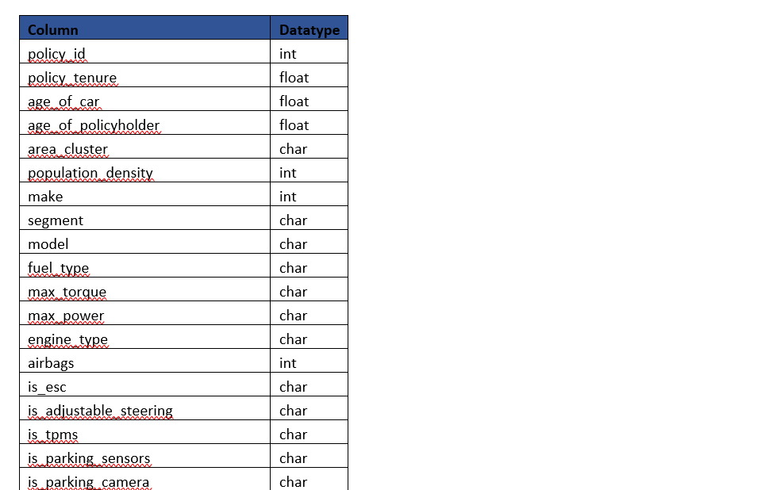
Data Source
https://www.kaggle.com/code/setumoraphelakamatlou/insurance-claim-xgbclassifer/data?select=train.csv

Slide 6
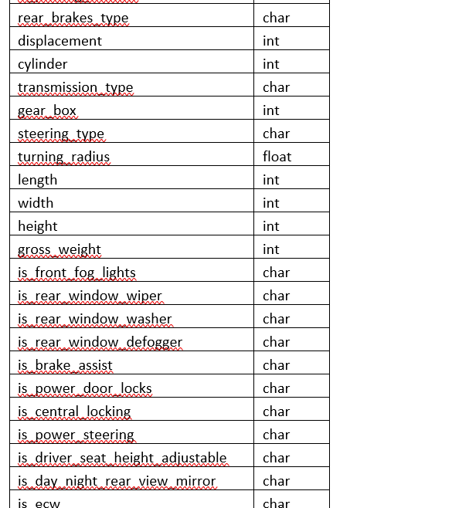
Continue…

Slide 7
Continue…
Total Variable: 44
Character Variable: 27
Integer Variable: 12
Float Variable: 4
Boolean: 1
Date: 0
DateTime:0
Target Variable: Is_Claim

Slide 8
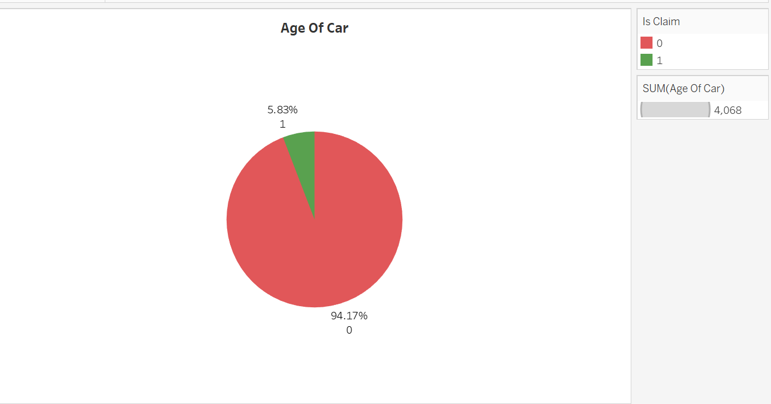
Visualization
The first graph shows age of car and the claim settlement ratio so car with less age has high chances of getting claims.

Slide 9
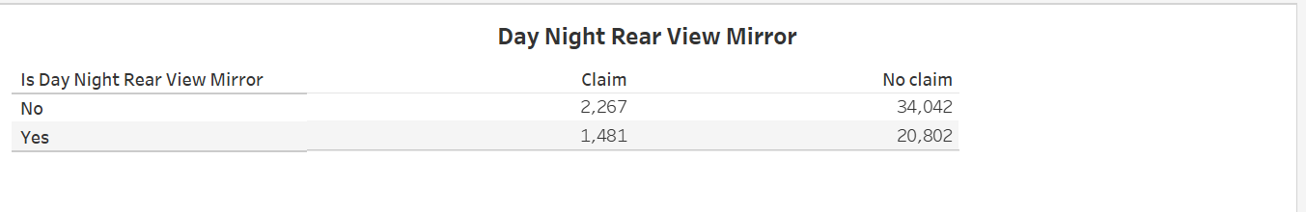
Having day night rear mirror doesn’t have that much effect on getting the claims settled

Slide 10
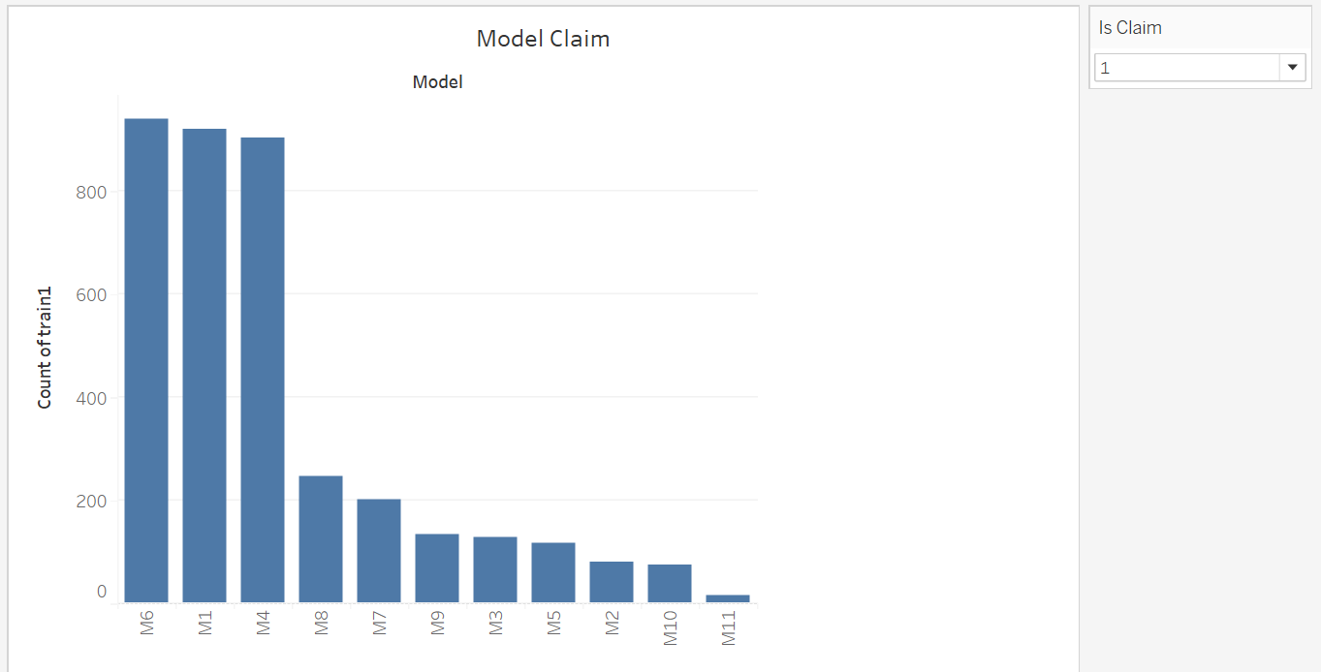
M6, M1 and M4 is leading

Slide 11
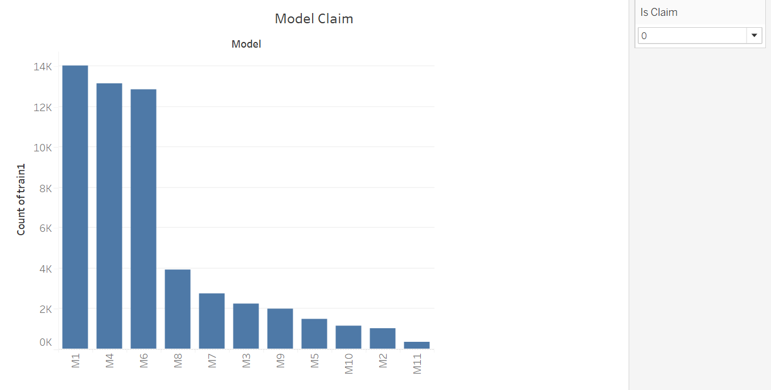
If we see both the data points it’s easily understandable using the graph that claim settlement is good with M6 model were for M1 its sort of both.

Slide 12
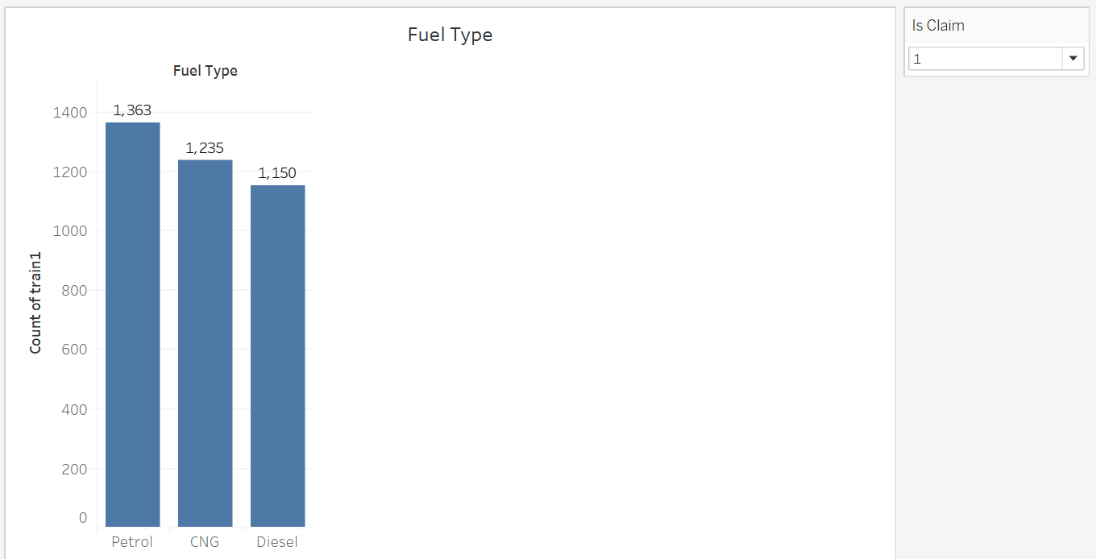
Petrol leads here

Slide 13
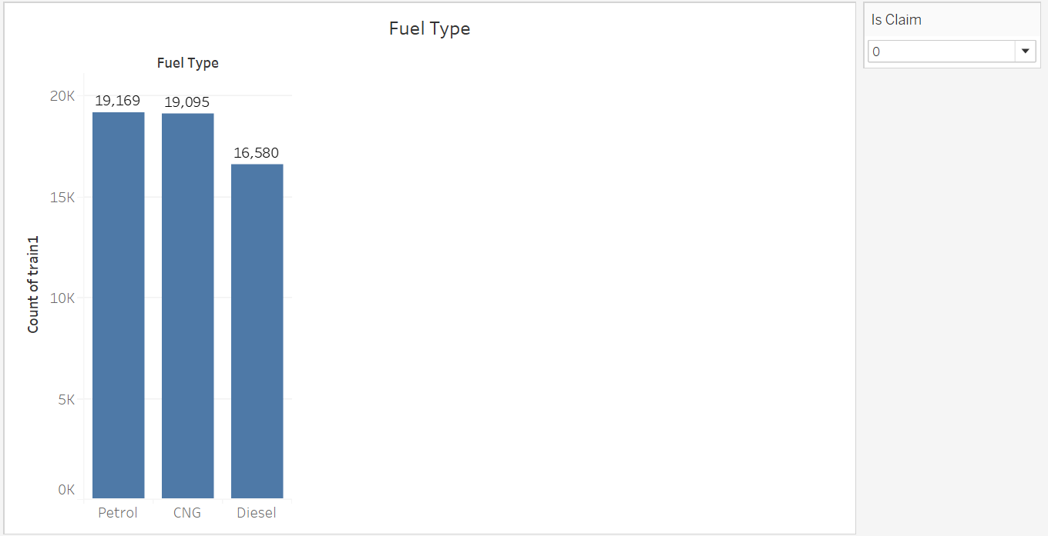
Claim settlement for Fuel type petrol is way better than other two.

Slide 14
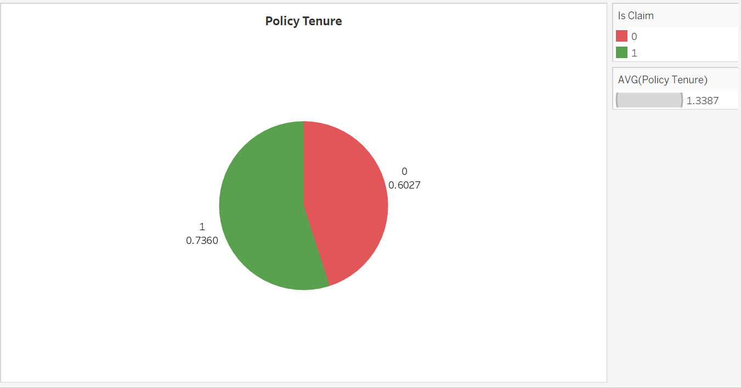
In this graph we are show casing the policy tenure. We have taken the average of policy tenure as the policy tenure increase the chances of car claim increases.

Slide 15
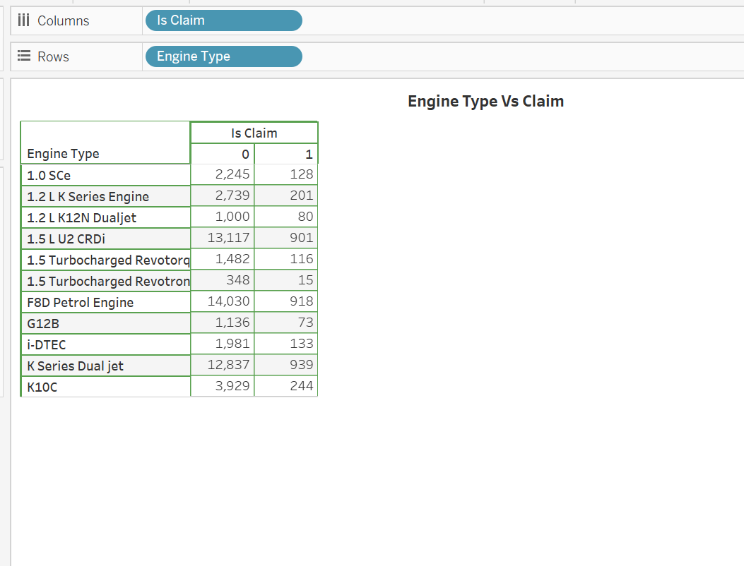
The graph shows the Engine type study with respect to claims.

Slide 16
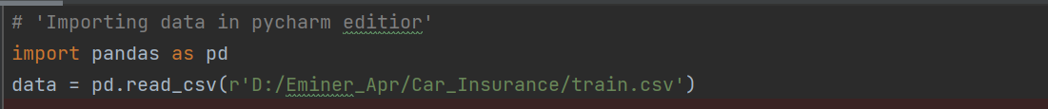
Data Exploration and Preprocessing
The dataset provided in the link is related to insurance claims, and it contains information about various attributes of insurance claims, such as the atransmission_type, gear_box, steering_type, turning_radius, length, width, height, gross_weight etc
Missing Data
Importing the data

Slide 17

Data Exploration and Preprocessing
Missing Data
There is no null values in data so each and every record can be used in model.

Slide 18

Data Exploration and Preprocessing
Inconsistent Data:
The dataset may also contain inconsistent data such as misspelled names or invalid entries, which can cause issues during analysis. It is necessary to clean such inconsistent data to avoid problems. In this dataset, we need to check for inconsistent data such as gender information.
Now let’s look into few of categorical variable and their distribution is there some data point which needs to be corrected or changed.

Slide 19
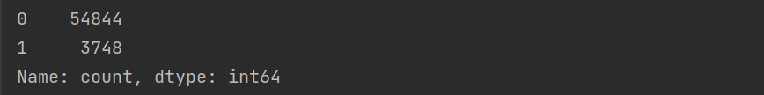
Data Exploration and Preprocessing
Inconsistent Data:
No discrepancy in is_claim which is our dependent variable
Checked other categorical variable also they are in sync

Slide 20
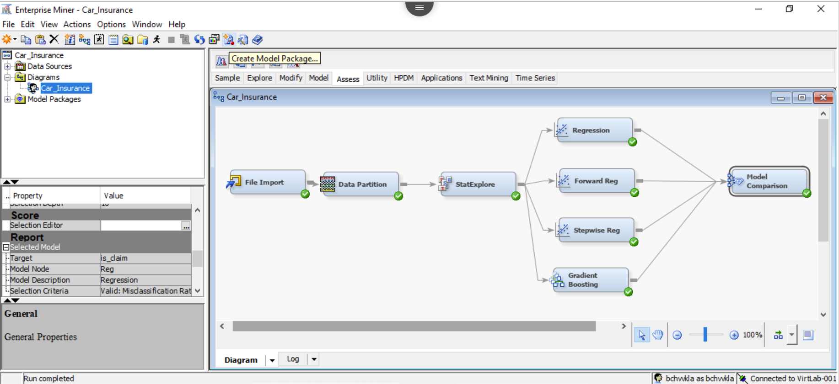
Overview of the models built
.

Slide 21
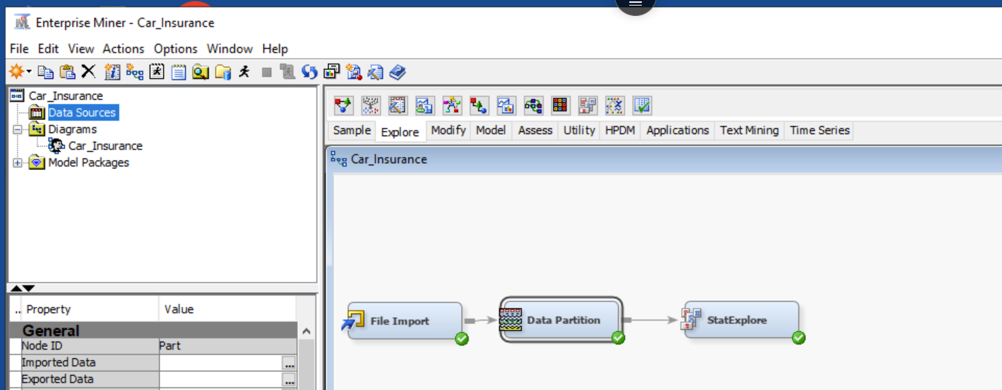
Exploration of Data
The data is divided in 50:50 ratio for Training and Validation.

Slide 22
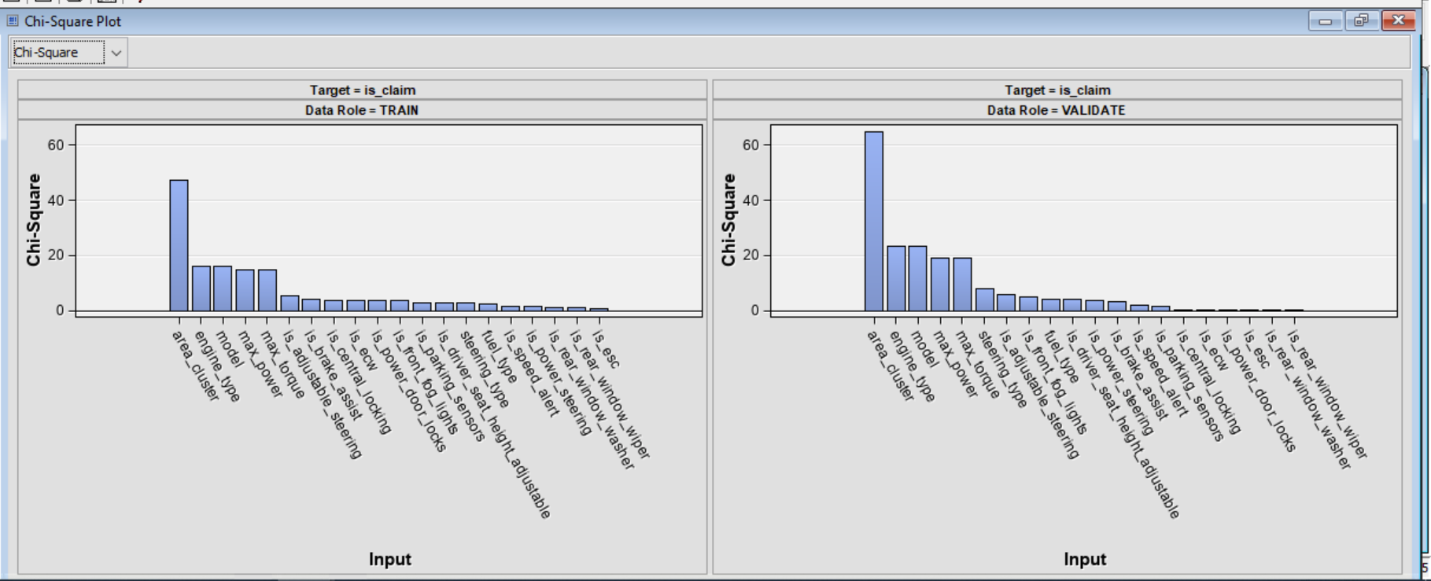
Stat Explorer Node
We can see for both training and validation the input variable priority is almost same leaving few of the variables like is_esc, ls_adjustable_steering.
The above test is called Chi-Square test which is used to determine if there is any significant difference between expected and observed frequencies.

Slide 23
Stat Explorer Node
The important variables from the test are expected to be where there is difference:
Area_cluster
Engine_Type
Model
Max_power
Max_Torque

Slide 24
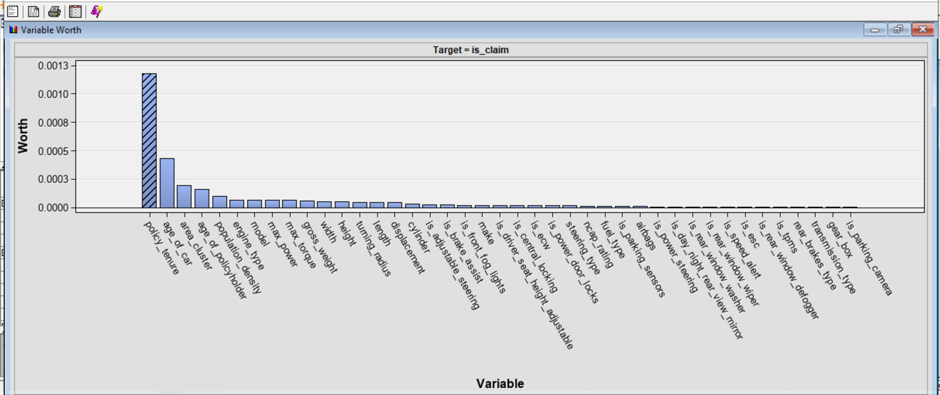
Variable Worth In prediction
Policy_Tenure
Age_of_car
Area_cluster
Age_of_policyholder

Slide 25
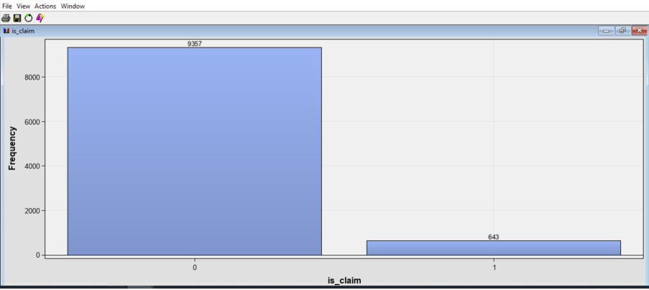
Distribution of Target Variable
So, if we see the distribution of target variable the distribution is not in good shape. 94% data says zero and only around 6% says 1 which doesn’t look good for model building.

Slide 26
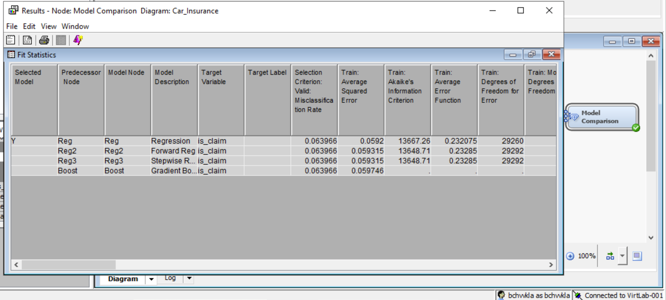
Best Model Selection
Simple logistic Regression is the best model

Slide 27
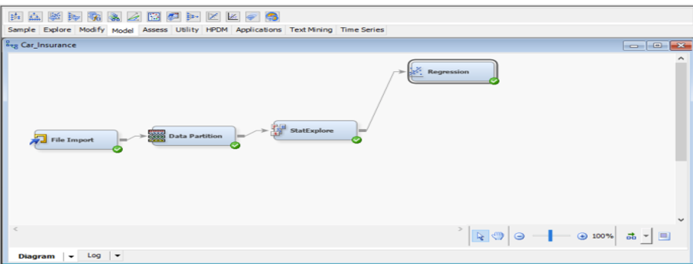
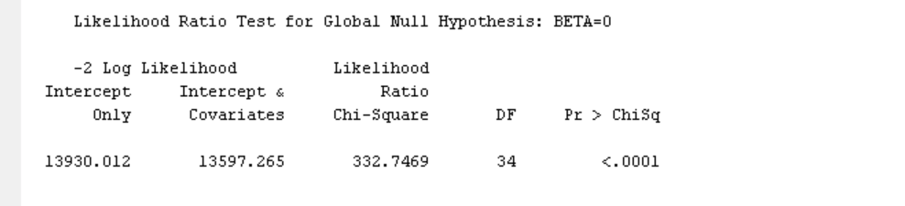
Logistic Regression (P is less than alpha)

Slide 28
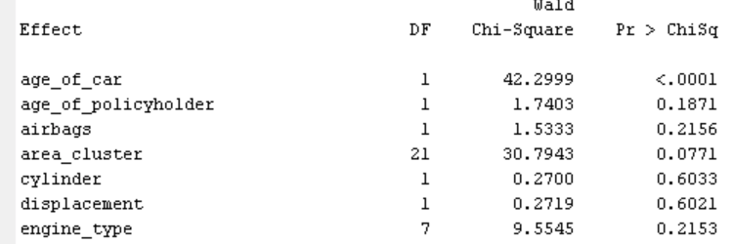
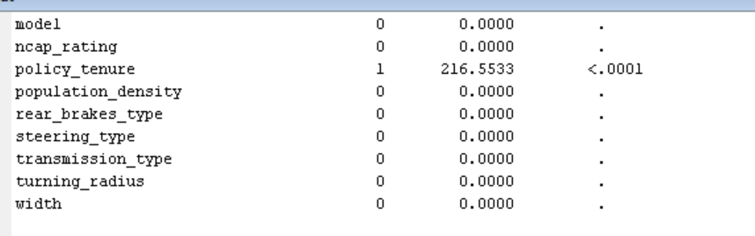
Important Variables
One with p value less than alpha is important variable for prediction

Slide 29
Important Variables
One with p value less than alpha is important variable for prediction

Slide 30
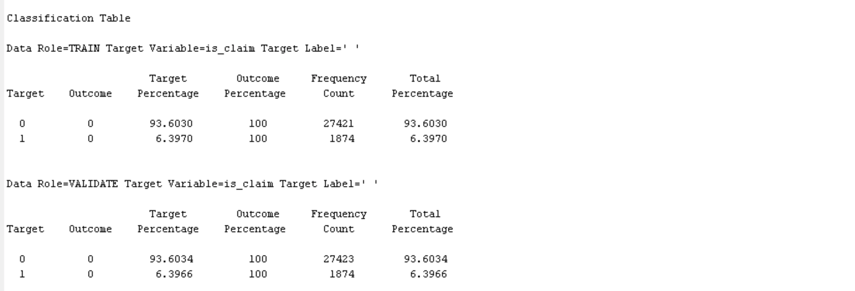
Classification Table

Slide 31
Interpretation and Recommendation
Interpretation
While data exploration the important variables were: Policy_Tenure, Age_of_car, Area_cluster, Age_of_policyholder
In model building for Regression model important variables were Age_of_car and Policy_tenure
While in case of gradient boosting there was an addition engine_type
As the target variable distribution was not up to mark most of model were not able to fit data
Decision tree failed so we included Gradient boosting which improved the model
A high misclassification rate is found due to imbalance data

Slide 32
Interpretation and Recommendation
Recommendation
The data needs to be corrected to get better result model wise
Other than regression model we can use boosting technique this might increase the performance of model

Slide 33
Summary and Lessons Learned
This project aimed to develop a predictive model to accurately predict the likelihood of an insurance claim being filed based on customer profile information. Data analysis was conducted to identify the most important features that influence the likelihood of an insurance claim being filed. The predictive model was then developed using machine learning algorithms and evaluated for accuracy.
Lesson Learned:
This project highlighted the importance of understanding the data and the features that influence the outcome of a predictive model. Also, analysis on the tableau helped to learn the concept of data visualization that helps in the further processes. Furthermore, it demonstrated the need to evaluate different machine learning algorithms and techniques to develop the most accurate model. Lastly, it highlighted the need to analyze the data for potential patterns that could be used to further improve the accuracy of the model.
Few things from technical front:
Different functionality and use of Tableau
Use of SAS Miner
Used Python, PyCharm IDE for data validation and cleansing

Slide 34
Future Extension
As part of future extension for this project, need to learn more about data and try to come up with more highly distributed data so that we can create our model accordingly.
Try some more boosting technique or neural network if required to get better results and as part of extension to the project will be adding few more visualization to understand the data better.

